Slide 1
Charting a New Course with Excel
Day 3
The Data Bootcamp | November 10, 2018

Slide 2
Admin Stuff

Slide 3
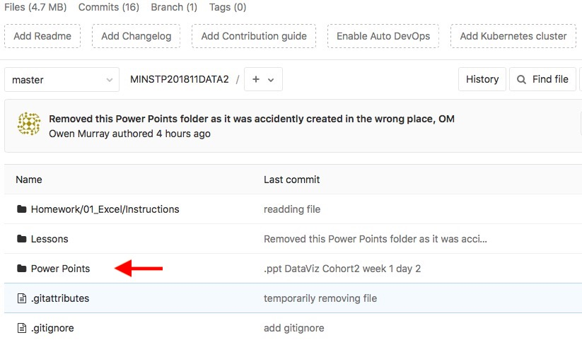
Class Git Lab (UPDATE)
All Class Content and Homework will be here:
<ENTER GIT LAB URL HERE>

Slide 4
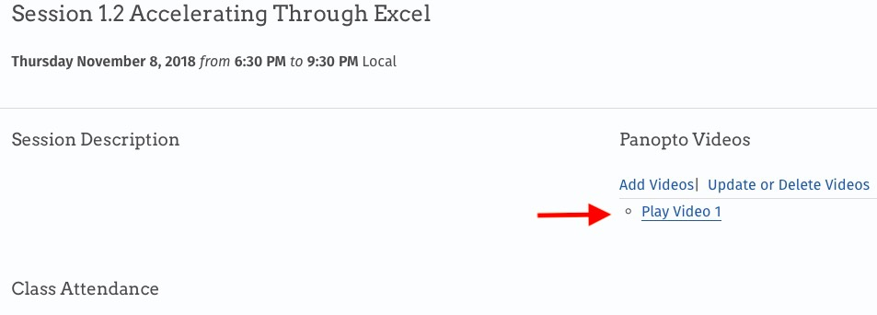
Class Videos (UPDATE)

Slide 5
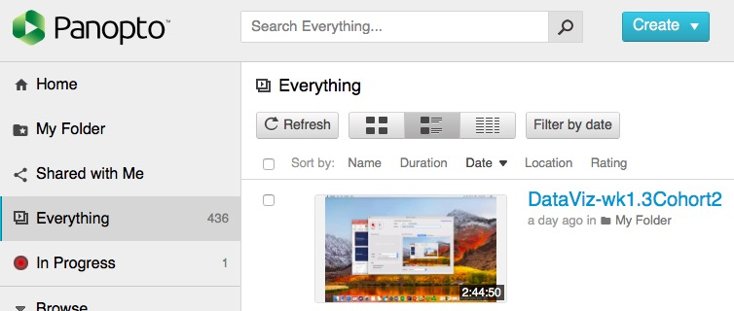
Class Videos (UPDATE)
Class Videos will be automatically uploaded here:
https://codingbootcamp.hosted.panopto.com/Panopto/Pages/Viewer.aspx?id=ecf38f04-31d4-4e0b-8d53-a993003f8f5b

Slide 6
Homework Assignment #1
You will be analyzing thousands of Kickstarter projects to look for funding trends across goal targets and topics.

Slide 7
Homework Assignment #1
Due: Next Saturday
Recommended Target: Thursday of Next Week

Slide 8
Quick Refresher

Slide 9
Function & Conditional A core building block in all languages
Function
=
AVG(
F4:F6
)
Variable
Arguments
Conditional = control flow of logic
=
IF(D2>5, TRUE, FALSE)
Variable Arguments
Compound Conditions
AND, NOT, OR

Slide 10
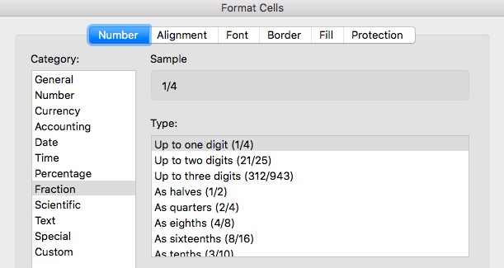
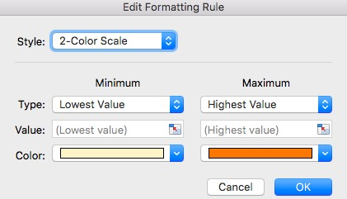
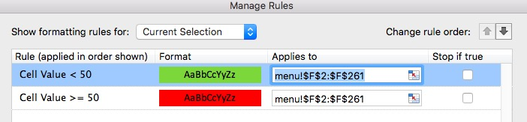
Formatting
Number Types
Conditional

Slide 11
Pivot Table
Seller | Qty. Sold | Date
Joseph | $42.50 | 1/1/17
Jacob | $65.00 | 1/3/17
Jacob | $5.25 | 1/6/17
Joseph | $125.00 | 1/6/17
Jacob | $3.50 | 1/7/17
Matt | $32.00 | 1/9/17
Seller | Total Sold
Joseph | $167.50
Jacob | $73.75
Matt | $32.0
Summative analytic tool that allows us to perform aggregate functions that along any combination of fields.

Slide 12
Look It Up with Lookups
Planet | Population
Zeelo | 5020
Merinoa | 380
Cardboard Box | 2
… | …
Asteroid 9 | 95
VLOOKUP searches data vertically in columns.
HLOOKUP searches data horizontally in rows.

Slide 13
Adding Files to GitHub
Visit https://github.com
Login to your personal accounts
From the main page, create a new repository with an initialized readme.md file
A readme is the landing page for each repository that will explain the codebase
Create a new empty Excel file save it and upload

Slide 14
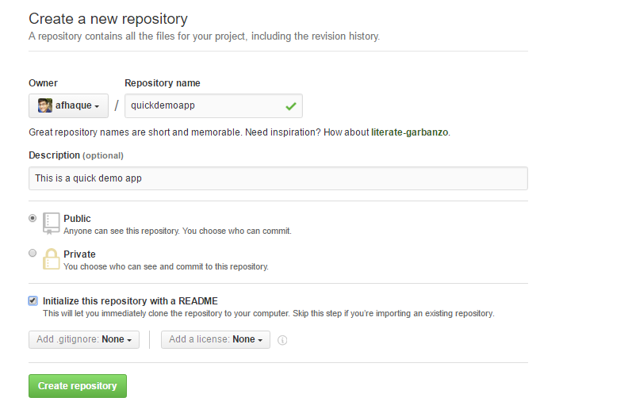
Create a New Repository

Slide 15
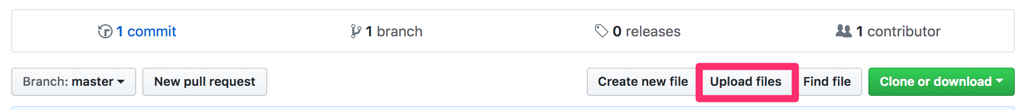
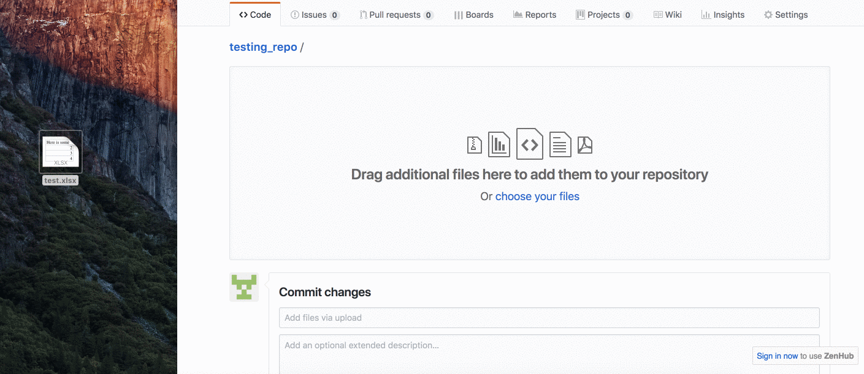
Upload File

Slide 16
Takeaways
This will be how you will be submitting your homework for the first two weeks
Add all of the necessary files to your Github repo then submit the repository link to BCS
Practice Github before the next class and come to office hours if you run in issues or need help

Slide 17
Today’s Agenda: MS Excel Visualization
Create
Modify
Style
Bar charts
Line graphs
Pie graphs
Scatter plots
Understand how to filter data using Excel
Know how to calculate moving averages and regressions

Slide 18
Basic Charting

Slide 19
Demo Time! Ice Cream Faves and Basic Charts

Slide 20
Group Activity: Line and Bar Grades
Create a series of bar graphs that visualize the grades of each student, one graph for every month.
Create a line graph using all of the data that can be used to compare students' grades across the semester.
Use filtering in the line graph to allow you to drill down to a specific student's progress throughout the semester.
Hint: When duplicating bar graphs, it pays to get the formatting and look of the chart where you want it for the first graph (e.g. for January) and to then copy that chart and re-select the data for the subsequent copies (keeping the style and format, but just changing the data).

Slide 21
Individual Activity: Line and Bar Grades

Slide 22
Review Line and Bar Grades
Filtering data within the line chart. Without picking and choosing which students we want to look at in specific, the chart is overcrowded and difficult to read. Sometimes, as in cases like this one, less data on a chart is better than more.
We also need to "Switch Row/Column" from the Chart Design menu on the line graph.

Slide 23
Scatter Plots

Slide 24
Demo Time! Scatter Plot

Slide 25
Group Activity: Video Game Sales

Slide 26
Class Activity! Review Video Game Sales

Slide 27
Filtering

Slide 28
Class Activity! The Need to Filter - PigeonRacing

Slide 29
Group Activity: Filter Video Game Sales

Slide 30
BREAK

Slide 31
Moving Averages

Slide 32
Moving Average Usage
To smooth out irregularities in data (large positive/negative spikes) to allow for easily recognizable trends.
While there are advantages in expressing how vastly values can change over time, there are times in which it would also be beneficial to show smoother progression.
Different from trend line in that the line of a moving average can change direction over time.
Should not be considered a replacement for more detailed graphs but should be added in on top of graphs to add more clarity.
The higher the interval the smoother the line will be.

Slide 33
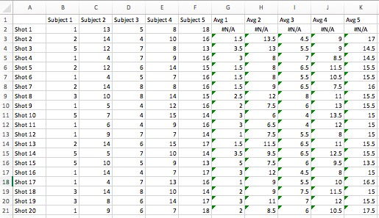
Group Activity: Golfing Target

Slide 34
Regression

Slide 35
Regression Usage
Regression lines can be used as a way of visually depicting the relationship between the independent (x) and dependent (y) variables in the graph.
Linear regression is relationship between a dependent variable and one or more explanatory or independent variables.
For example, more ice cream gets sold when the temperature goes up. Ice cream sales are our dependent variable and the temperature is and independent variable.
https://projects.ncsu.edu/labwrite/res/gt/gt-reg-home.html

Slide 36
Group Activity: NBA Stats
Run a regression analysis on the 2017 NBA season stats.
Use `PTS` as your Y variable, or dependent variable.
Determine which X variables, or independent variables, to use.
After having run regression, explain why your choice was or was not a good choice.
Do the results have a good `R Square` value?
Is your choice statistically reliable?
Explain what your coefficients mean.
Finally produce a scatter plot and explain your overall analysis.

Slide 37
Class Activity: Review Regression
R Square is how close data is to a fitted line, the closer to 1.0 the better, the value in this example is 0.49, which is not as great as we would like it to be.
Multiple R. This is the correlation coefficient. It tells you how strong the linear relationship is. Where a value of 1 means a perfect positive relationship and a value of zero means no relationship at all. It is the square root of r squared.
Significance F and P-values let us tell how reliable the data is. Values under 0.05 are good, and anything higher means new independent variables should be selected. The value here is 0 so the data is likely be very reliable.
Coefficients is saying that for each unit increase in price there is an increase 280.623 square feet of living space.

Slide 38
Questions / Discussion
Notes:
It’s important to keep in mind why you joined this class. Let’s talk about your goals.

